Slide 1
Final Project
Bluetooth
Benjamin Dzado
CSE-354
BYU- Idaho Computer Engineering

Slide 2

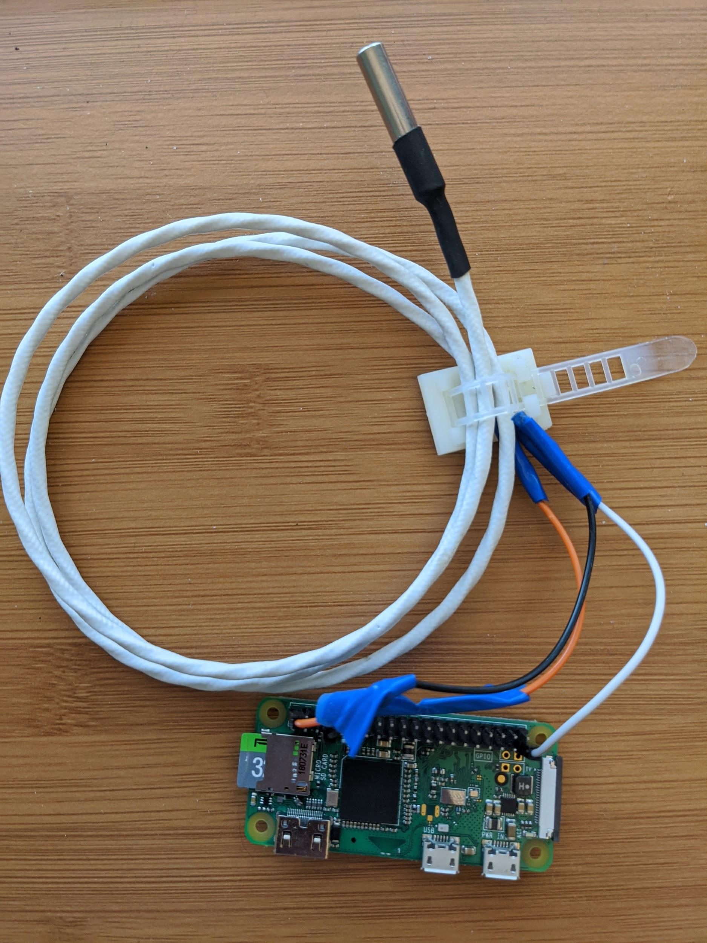
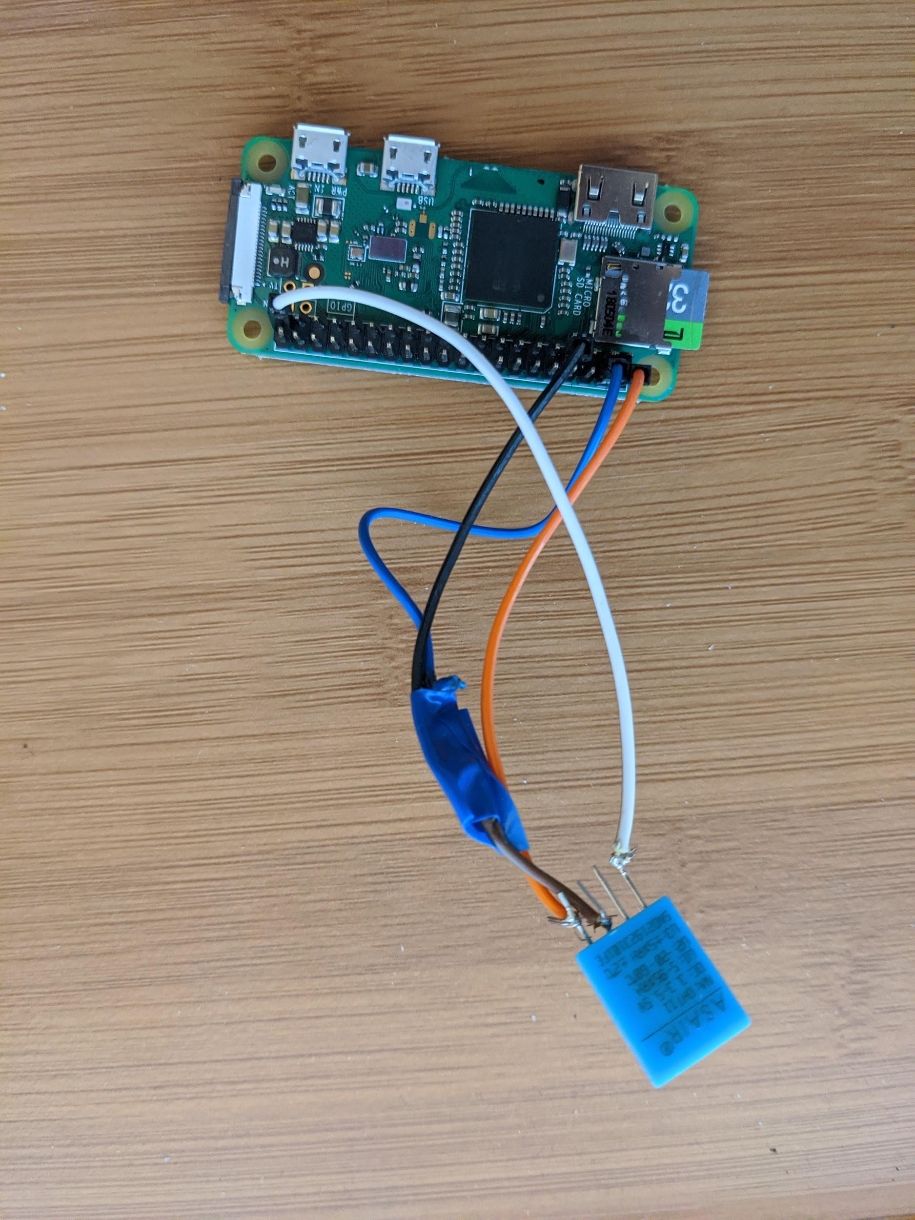
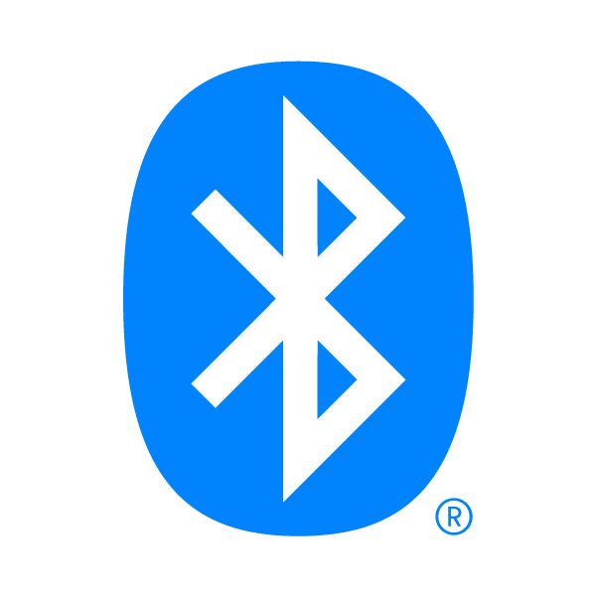



Overview
Temperature
Temperature and Humidity
1Wire
1Wire

Slide 3
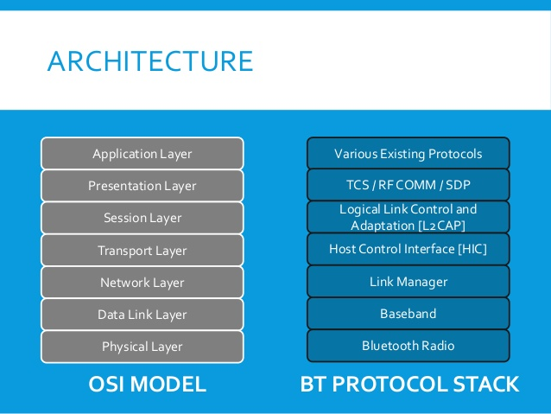
The Bluetooth Stack
Unlike Wi-Fi, Bluetooth is not just a data link layer protocol.
It has its own network stack called the Bluetooth stack
Very similar but limited compared to the network stack.
Has a lot of its own protocols

Slide 4
More Bluetooth info
Bluetooth Profiles - defines a set of commands and functionality that 2 Bluetooth devices can interact with each other. Both devices must be able to support the same profile in order to talk to each other.
Universally Unique Identifier - a 128-bit identifier that should be globally unique that are not just used by Bluetooth
Attributes -

Slide 5
Questions?

